Slide 1
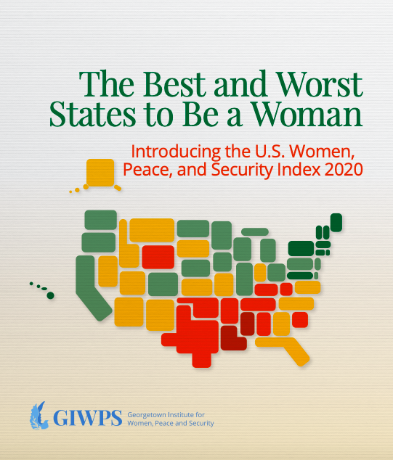
#USAindex
Jeni Klugman
October 8, 2020
Notes:
Inspired by the global WPS index first published in 2017 and updated in 2019 that measures the wellbeing of women in 167 countries
This index applies a similar methodology to the 50 states and DC
In the ten minutes now I will cover ABCDE.

Slide 2
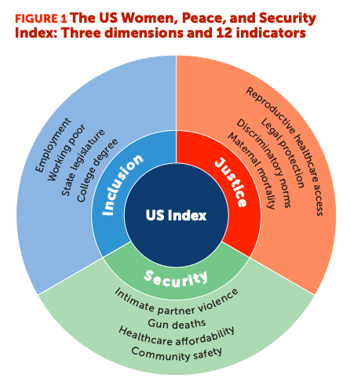
Notes:
I thought it would be best to start by showing exactly what is in the US WPS Index – we capture three dimensions of women’s status and well-being, namely inclusion, justice and security, each of which is measured in terms of four indicators, for a total of 12 indicators. All the data comes from reliable public sources, and is for the most recent year possible.
The indicators are equally weighted, and the scores range from zero to one.

Slide 3
Structure of the report
Chapter 1: Introducing the US Women, Peace, and Security Index
Chapter 2: Key results and highlights
Chapter 3: Understanding disparities and behind the dimensions
Statistical Tables – Full set of indicators, available data on racial disparities, and on gender gaps
Data for the index drawn from existing sources, including:
US Census Bureau
CDC
Guttmacher Institute
Center for American Women in Politics
Complemented by a new nationally representative survey of 2600 adults, conducted with YouGov and PerryUndem in August, covering gender, racial inequalities, and COVID-19.
Notes:
The report we are launching today introduces the new index, explaining the structure, rationale and methodology in chapter 1. The second chapter xx. The thirdyy
Oversamples of Black and Latinx women, and the top and bottom states
Multiple choice and open-ended questions

Slide 4
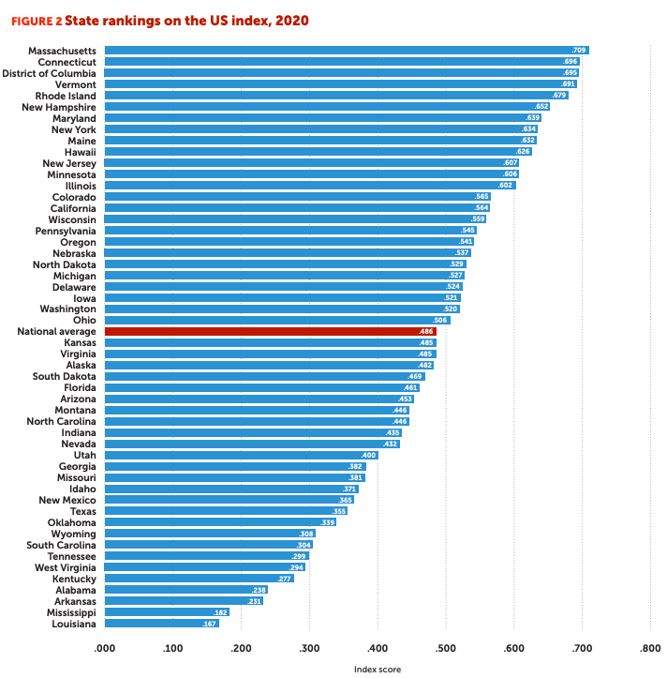
Vast disparities – with top ranked Massachusetts scoring almost four times bottom ranked Louisiana
Notes:
So to cut to the chase, Massachusetts is at the top – indeed scoring four times higher than the bottom ranked state, Louisiana.
Despite MA’s strong overall performance, racial inequalities are stark. Nearly half (45 percent) of white women in MA have a bachelor's degree, compared to only a quarter of Black women. According to our survey, 40 percent of women of color have less than $200 in savings, and 26 percent reported not having enough money to pay for bills and basic needs, such as housing. Latinx women make only 51 cents for every dollar paid to white men.
Indeed there are vast differences across states overall – and for specific indicators.
The largest disparities are in legal protections and access to reproductive health services.
In Wyoming, fewer than 1 in 20 women live in a county with an abortion provider, compared with 19 in 20 women in California, Connecticut, Hawaii, and the District of Columbia.
I will talk later about our measure of legal protection – but just to mention here that only 9 states have mandated paid parental leave and only 7 set the minimum wage above the low income threshold of $12 (can swap with: on 13 states require domestic violence perpetrators subject to protective orders to relinquish their firearms)

Slide 5
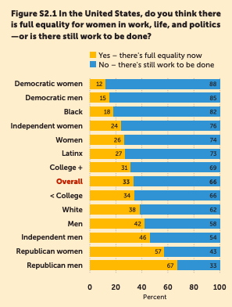
Insights from our new survey
Overall, two-thirds of Americans think that more work has to be done to achieve full equality in the United States.
Democrats and Black Americans are much more likely to say that there is more to do.
Notes:
Our index and report are complimented by findings from a nationally representative survey
Four in five adults believe that it is important for elected officials to work on issues affecting gender equality
2/3 adults believe that the country would be better off with more women in political office
most adults in our survey see women’s access to affordable birth control, abortion, livable wage jobs, equal pay, parental leave, and affordable healthcare as important components of gender equality. Most adults also recognize that only a minority of women in the United States have access to these services and opportunities.

Slide 6
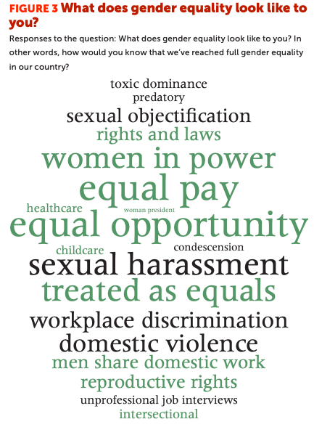
Notes:
When asked what gender equality looks like to them, respondents most commonly cited equal pay, equal opportunity, and the absence of sexual harassment as key criteria.

Slide 7
Clear patterns in regional performance
Notes:
It would come as no surprise that there are clear patterns in regional performance
Most obviously: all 6 states in the Northeast region are among the 10 best performing states nationally, shown here in dark green, while all 5 of the worst performing states are in the Southeast region
Yet location is not a sole determinant: there are major differences within regions. Thus, while Colorado ranks 14th overall, its neighbors, Utah and Wyoming, rank 36th and 43rd.

Slide 8
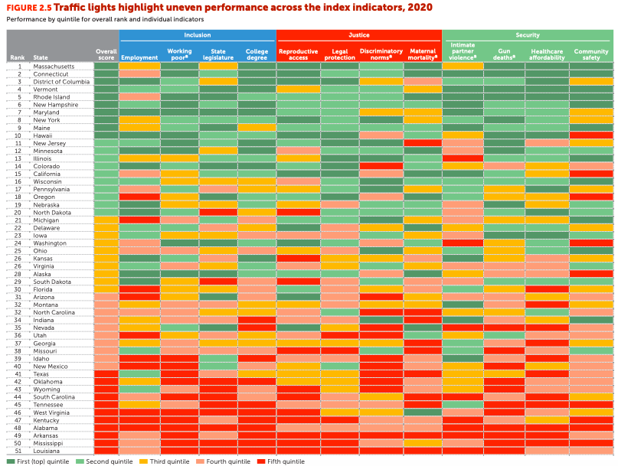
Notes:
These traffic lights captures the relative performance of each state on each indicator
New Hampshire is the only state that does well (scores in the top two quintiles) across all 12 indicators
Three states (Louisiana, Arkansas, and Alabama) score in the bottom two quintiles for all indicators
Shows that even states that rank highly have work to do
For example, New Jersey has low rates of women working while in poverty (4%) and high rates of college degree attainment (41%), but last the fourth highest rate of maternal mortality in the country – at 46 deaths per 100,000 live births.
Similarly, Oregon tops the charts in legal protections for women, but is in the bottom ten for women’s employment.

Slide 9
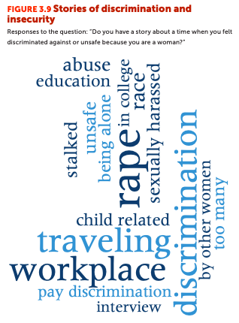
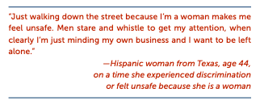
Women face serious security and justice constraints
Nearly 80 percent of men feel safe walking within a mile of their neighborhood at night, while the same is true for only 56 percent of women, based on the University of Chicago’s General Social Survey.
Notes:
Emphasis on justice and security for women are key innovations of this index and are central to wellbeing.
Almost half of women respondents to our YouGov/PerryUndem survey said that they “feel unsafe because they are a woman” frequently or sometimes in their daily life
About 60 percent of women in the Southeast region, including Alabama, Kentucky, and Mississippi, report feeling afraid to walk alone at night near their own neighborhood
Intimate partner violence levels are relatively low, though while only about 4 percent of women in the United States have reported intimate partner violence in the past 12 months, about a quarter have experienced violence at the hands of an intimate partner at some point in their life,
State-level data on IPV also hasn’t been collected in over ten years, highlighting huge data gaps that urgently need to be filled.

Slide 10
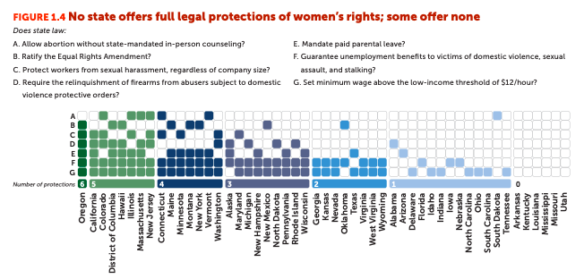
The state in which a woman lives determines her ability to file a workplace sexual harassment claim, her level of protection from an abusive partner, and whether she can take paid time off for caregiving.
Notes:
While no state had all seven legal protections in place, Oregon had the strongest legal protections for women, scoring six out of seven. Six states—Arkansas, Kentucky, Louisiana, Mississippi, Missouri, and Utah—scored zero. In these six states, abusers subject to domestic violence protective orders are not required to relinquish their firearms, in-person counseling is mandatory for women to have an abortion, and the minimum wage is below the low-income threshold of $12 an hour.

Slide 11
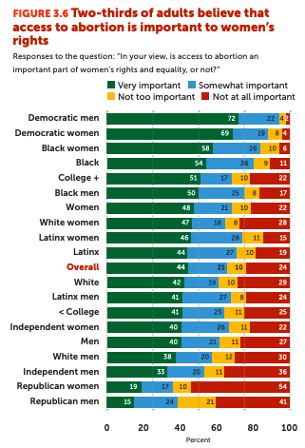
Overall support for women’s sexual and reproductive healthcare is strong, with 65 percent of adults believing that access to abortion is important to women’s rights.
However, support us much lower among Republicans
Notes:
Access to sexual and reproductive healthcare, including abortion, is a core component of justice for women.
Overall support for women’s sexual and reproductive healthcare is strong, with 65 percent of adults believing that access to abortion is important to women’s rights.
However, support us much lower among Republicans – roughly two thirds of republican men and women believe access to abortion is not important to women’s rights.

Slide 12
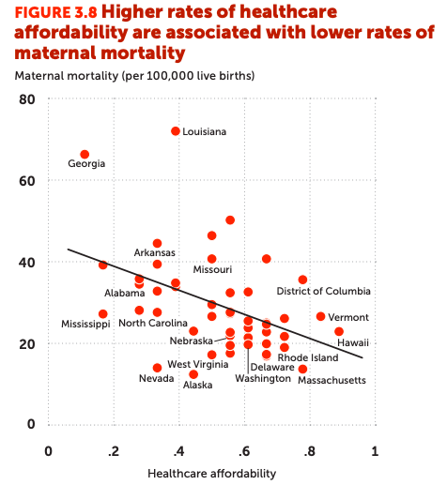
Key factors explaining performance
Good things often go together
Multivariate analysis finds that states which do better tend to be :
Richer
More urban
Controlled by the Democratic party for more years, and
Less racially diverse
Notes:
More affordable healthcare is correlated with lower rates of maternal mortality
Healthcare affordability is key to women’s physical and mental wellbeing, though varies greatly by state.
In Georgia, MS, and TX, 20 percent of women report not seeing a doctor in the past year due to cost, compared to the national average of 14 percent.
In Utah, 42 percent of Native American women report not seeing a doctor in the past year due to cost

Slide 13
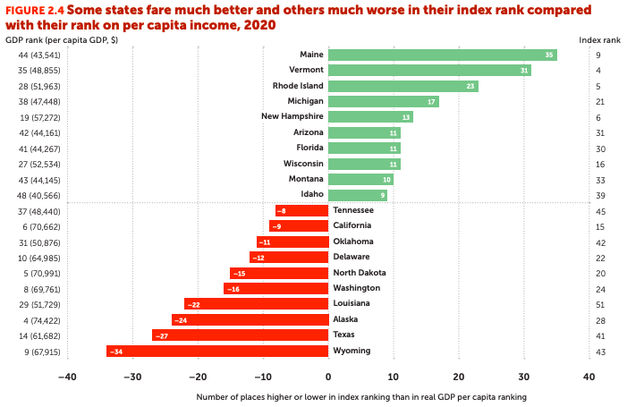
Money matters, but not the whole story
Notes:
some states do far better on the US WPS Index—or far worse—than their per capita income rank, suggesting that money is not the whole story.
For example, Maine ranks 44th in per capita GDP but 9th on the index—a 35-place gap. Wyoming, on the other hand, ranks 34 places lower on the index than its GDP per capita rank

Slide 14
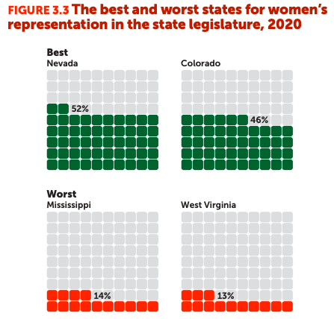
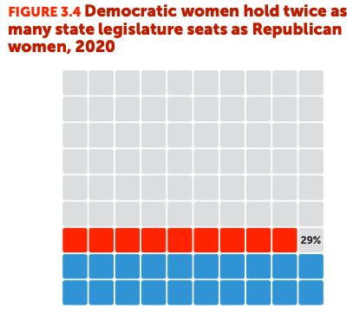
Only one state currently has gender parity in political representation
Notes:
Looking specifically at the political aspect of inclusion, the share of women in the state legislature …
Nevada is the only state to reach gender parity in the state legislature
In seven states (Alabama, Louisiana, Mississippi, Tennessee, South Carolina, West Virginia, and Wyoming) fewer than one in five state legislators are women, ranging as low as 13 percent in West Virginia - this rate is approximately the same as in Ghana, Syria, and Burkina Faso
At current rates of progress, gender parity in state legislature won’t be reached until 2057.

Slide 15
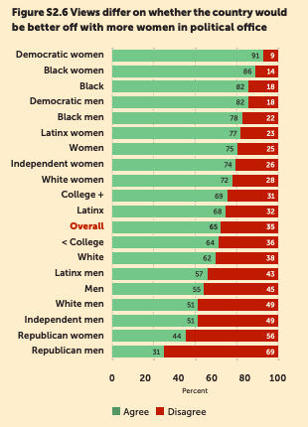
Solid majority overall support more women in political office
Support strongest among Democrats and Black Americans.
Least among Republicans and white men
Notes:
REWRITE
Solid majority overall support more women in office
Support strongest among Democrats and Black Americans.
Least among Republicans and white men
Almost half of white men disagree that the country would be better off with more women in political office. Nearly 70 percent of Republican men think the same. By comparison, 91 percent of Democratic women do believe the country would be better off with more female leadership.
Interestingly, although 55 percent of Mississippi residents see benefits from having more women in office according to our YouGov/PerryUndem survey, women represent only 14 percent of state legislators.

Slide 16
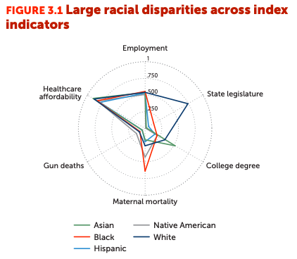
Major racial gaps among women in the US
College education
Achieved by more than ½ of Asian women and over 1/3 of white women have bachelor’s degrees
But only ¼ of Black women and fewer than a 1/5 of Hispanic women.
Politics –
3/ 4 of female state legislators are white
No Native American women legislators in 37 states and the District of Columbia.
Healthcare affordability
3 in 10 Hispanic women in Arkansas, Georgia, Oklahoma, Missouri, North Carolina, and South Carolina report not seeing a doctor in the past year due to cost
Notes:
gaps are most marked in the inclusion dimension, with wide disparities in women’s representation in state legislatures and college degree acquisition
The systemic forces behind these disparities are driven by explicit and implicit discrimination
Major racial gaps

Slide 17
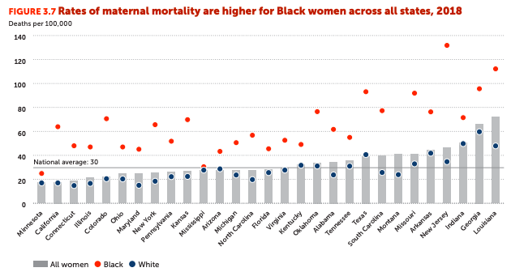
Notes:
Maternal mortality rates are higher for Black woman than for white women in all states. Though data are missing for several states.
For Black women in New Jersey, maternal mortality rates average 132 deaths per 100,000 live births, nearly quadruple that for white women in the state and 4.4 times the national average. This rate is similar to that in Venezuela and worse than that in Iraq and Nicaragua

Slide 18
The ways forward
Tackle overlapping disadvantage – and especially constraints facing
Close gaps in legal protection – from economic protections to ensuring abusers do not have access to firearms.
Ensure access to the full range of reproductive health services
Promote women’s voice – boost political representation
Enhance data availability – especially on intimate partner violence, financial inclusion, and ensure that data are racially disaggregated.
And VOTE !!
Notes:
Efforts to advance gender equality must also address racial injustice.
We hope that this and future editions of the US WPS Index will help hold decisionmakers accountable and guide efforts to advance the status of women in the United States for all women and girls.

