Slide 1
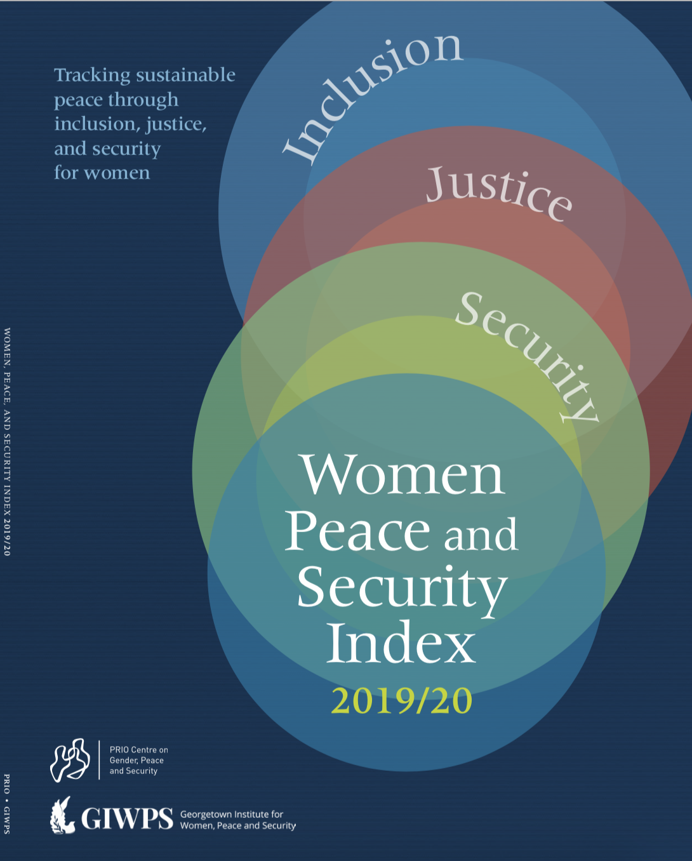
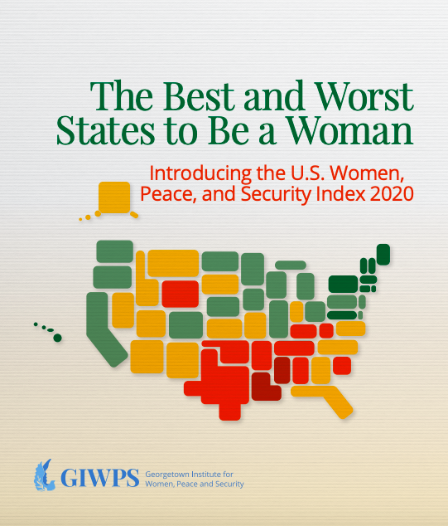
#USAindex
Presentation to the Louisiana Public Health Institute
Jeni Klugman
February 2, 2021
Notes:
Inspired by the global WPS index first published in 2017 and updated in 2019 that measures the wellbeing of women in 167 countries
This index applies a similar methodology to the 50 states and DC
In the ten minutes now I will cover ABCDE.

Slide 2
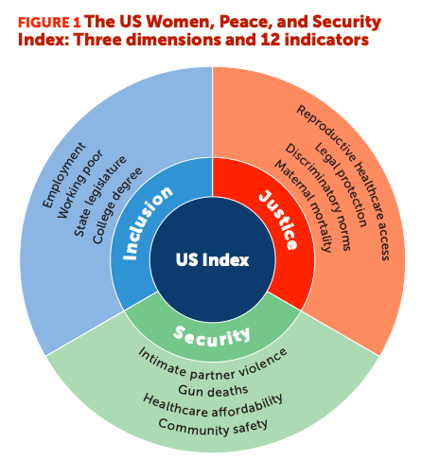
Notes:
I thought it would be best to start by showing exactly what is in the US WPS Index – we capture three dimensions of women’s status and well-being, namely inclusion, justice and security, each of which is measured in terms of four indicators, for a total of 12 indicators. All the data comes from reliable public sources, and is for the most recent year possible.
The indicators are equally weighted, and the scores range from zero to one.

Slide 3
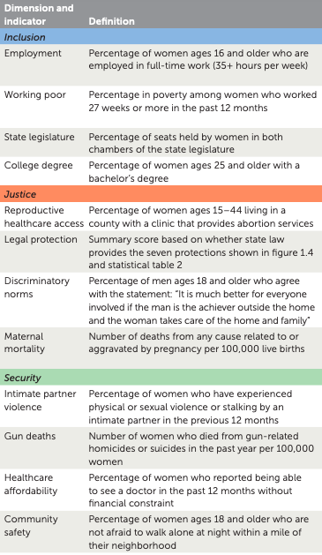
Data sources:
Census Bureau (through IPUMS)
Center for American Women in Politics
Guttmacher Institute
CDC
America’s Health Rankings
General Social Survey
Kaiser Family Foundation
Legal indicator sources:
Economic Policy Institute
Legal Momentum
A Better Balance
Georgetown University Law School
Giffords Law Center
Alice Paul Institute
Guttmacher Institute
*
*Indicates that data are regional. West; Rocky Mountains; Southwest; Midwest; Northeast; Mid-Atlantic;
Southeast = Alabama, Arkansas, Florida, Georgia, Kentucky, Louisiana, Mississippi, North Carolina, South Carolina, Tennessee, Virginia, West Virginia.
*

Slide 4
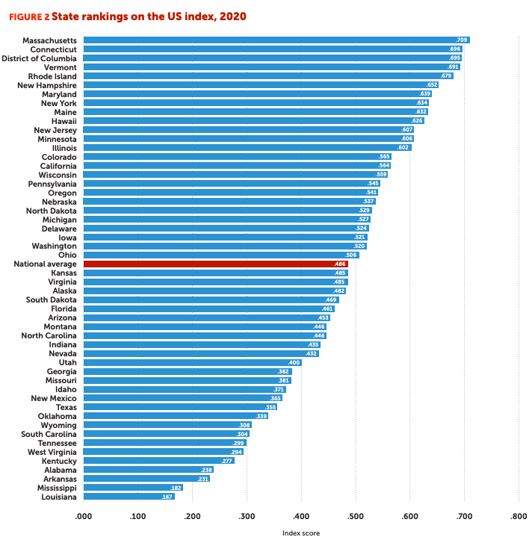
Vast disparities across states Top ranked Massachusetts scores almost four times higher than bottom ranked Louisiana
Notes:
So to cut to the chase, Massachusetts is at the top – indeed scoring four times higher than the bottom ranked state, Louisiana.
Despite MA’s strong overall performance, racial inequalities are stark. Nearly half (45 percent) of white women in MA have a bachelor's degree, compared to only a quarter of Black women. According to our survey, 40 percent of women of color have less than $200 in savings, and 26 percent reported not having enough money to pay for bills and basic needs, such as housing. Latinx women make only 51 cents for every dollar paid to white men.
Indeed there are vast differences across states overall – and for specific indicators.
The largest disparities are in legal protections and access to reproductive health services.
In Wyoming, fewer than 1 in 20 women live in a county with an abortion provider, compared with 19 in 20 women in California, Connecticut, Hawaii, and the District of Columbia.
I will talk later about our measure of legal protection – but just to mention here that only 9 states have mandated paid parental leave and only 7 set the minimum wage above the low income threshold of $12 (can swap with: on 13 states require domestic violence perpetrators subject to protective orders to relinquish their firearms)

Slide 5
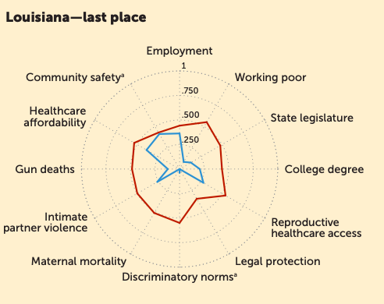
Spotlight on Louisiana

Slide 6
Index results complemented by insights from a new survey
In partnership with YouGov and PerryUndem, GIWPS conducted a nationally representative survey to explore public opinion toward the status, rights, and opportunities of women in the United States.
2,598 adults ages 18 and older from August 7-18, 2020
30 multiple choice and 4 open-ended questions
Oversamples of Black and Latinx women nationwide, as well as residents of the top two and bottom two ranked states.
333 adults from Louisiana

Slide 7
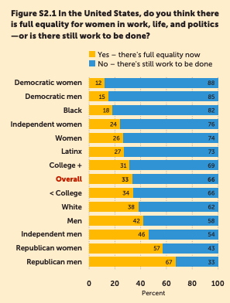
Insights from our new survey
Overall, two-thirds of Americans think that more work has to be done to achieve full equality in the United States.
Democrats and Black Americans are much more likely to say that there is more to do.
In Louisiana, 73 percent of women and 58 percent of men believe there’s more work to be done. Only 38 percent of white men say the same.
Notes:
Our index and report are complemented by findings from a nationally representative survey
Four in five adults believe that it is important for elected officials to work on issues affecting gender equality
2/3 adults believe that the country would be better off with more women in political office
most adults in our survey see women’s access to affordable birth control, abortion, livable wage jobs, equal pay, parental leave, and affordable healthcare as important components of gender equality. Most adults also recognize that only a minority of women in the United States have access to these services and opportunities.

Slide 8
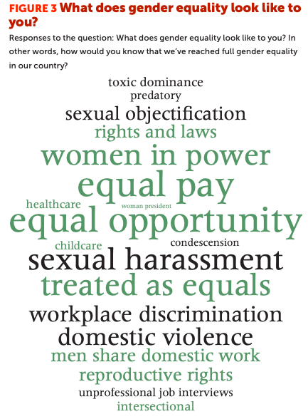

Slide 9
We asked Louisiana residents why they think their state ranks worst:
“Because there's still a lot of racism in this state, and this is just a male dominated state in regards to politics and other things. The south is steeped in tradition where men are the breadwinner and women stay home and care for the home.” –Black woman, age 38
"This state has a long history of racism and sexism. Little has been done to bring communities together in order to understand the challenges." -- Hispanic man age 59
"Lack of access to education, a conservative culture that believes that women should remain in the home, and a strong anti-abortion Catholic culture. Also a high percentage of single mothers, making it harder to finish education or have access to higher-paying jobs." -- white women age 31

Slide 10
Clear regional patterns in performance
Notes:
It would come as no surprise that there are clear patterns in regional performance
Most obviously: all 6 states in the Northeast region are among the 10 best performing states nationally, shown here in dark green, while all 5 of the worst performing states are in the Southeast region
Yet location is not a sole determinant: there are major differences within regions. Thus, while Colorado ranks 14th overall, its neighbors, Utah and Wyoming, rank 36th and 43rd.

Slide 11
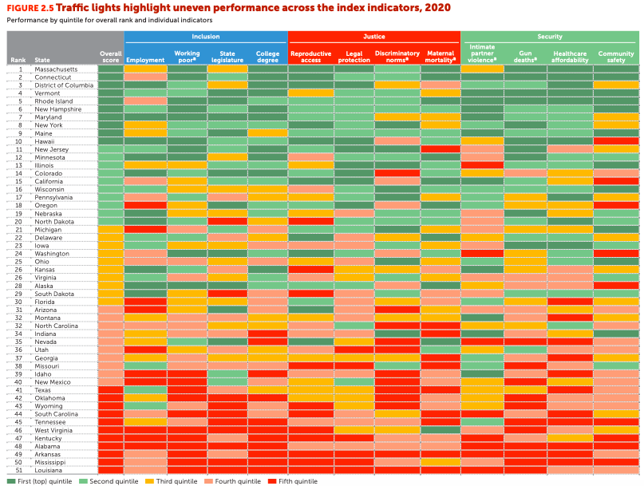
Notes:
These traffic lights captures the relative performance of each state on each indicator
New Hampshire is the only state that does well (scores in the top two quintiles) across all 12 indicators
Three states (Louisiana, Arkansas, and Alabama) score in the bottom two quintiles for all indicators
Shows that even states that rank highly have work to do
For example, New Jersey has low rates of women working while in poverty (4%) and high rates of college degree attainment (41%), but last the fourth highest rate of maternal mortality in the country – at 46 deaths per 100,000 live births.
Similarly, Oregon tops the charts in legal protections for women, but is in the bottom ten for women’s employment.

Slide 12
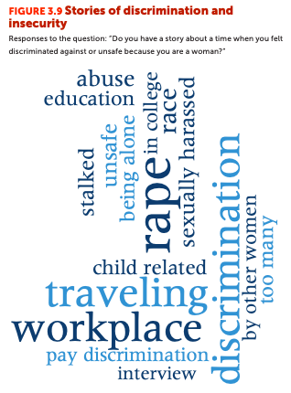
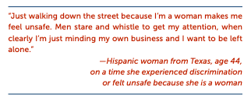
Women face serious security and justice constraints
Nearly 80 percent of men feel safe walking within a mile of their neighborhood at night, but only 56 percent of women
University of Chicago’s General Social Survey.

Slide 13
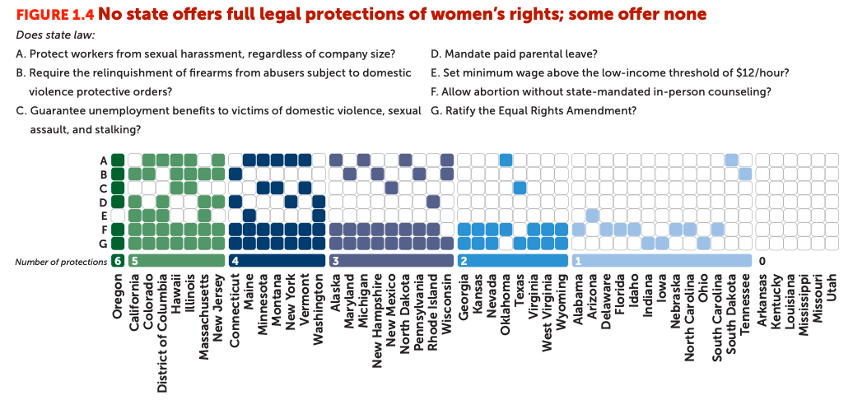
Gaps in legal protection
The state in which a woman lives determines her ability to file a workplace sexual harassment claim, her level of protection from an abusive partner, and whether she can take paid time off for caregiving.
Notes:
While no state had all seven legal protections in place, Oregon had the strongest legal protections for women, scoring six out of seven. Six states—Arkansas, Kentucky, Louisiana, Mississippi, Missouri, and Utah—scored zero. In these six states, abusers subject to domestic violence protective orders are not required to relinquish their firearms, in-person counseling is mandatory for women to have an abortion, and the minimum wage is below the low-income threshold of $12 an hour.

Slide 14
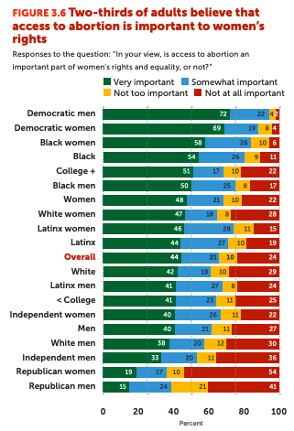
Overall support for women’s sexual and reproductive healthcare is strong, with 65 percent of adults believing that access to abortion is important to women’s rights.
However, support is much lower among Republicans.
In Louisiana, 87 percent of men of color believe abortion is important to 38 percent of white men.
Notes:
Access to sexual and reproductive healthcare, including abortion, is a core component of justice for women.

Slide 15
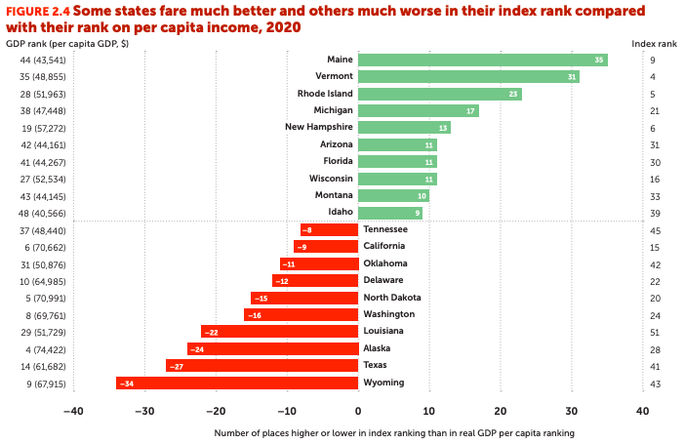
Key factors explaining performance
Multivariate analysis finds that states which do better tend to be :
More urban
Controlled by the Democratic party for more years
Less racially diverse
Richer
Louisiana ranks 22 places worse on the Index than on per capita income
Notes:
More affordable healthcare is correlated with lower rates of maternal mortality
Healthcare affordability is key to women’s physical and mental wellbeing, though varies greatly by state.
In Georgia, MS, and TX, 20 percent of women report not seeing a doctor in the past year due to cost, compared to the national average of 14 percent.
In Utah, 42 percent of Native American women report not seeing a doctor in the past year due to cost

Slide 16
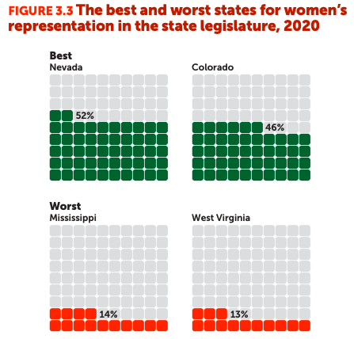
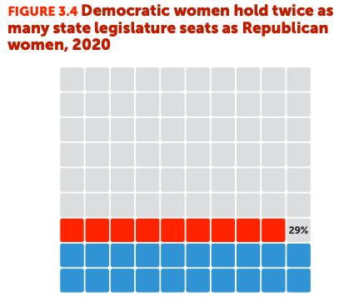
Only one state currently has gender parity in political representation
In Louisiana, only 15 percent of state legislators are women
Source: Center for American Women in Politics 2020.
Notes:
Looking specifically at the political aspect of inclusion, the share of women in the state legislature …
Nevada is the only state to reach gender parity in the state legislature
In seven states (Alabama, Louisiana, Mississippi, Tennessee, South Carolina, West Virginia, and Wyoming) fewer than one in five state legislators are women, ranging as low as 13 percent in West Virginia - this rate is approximately the same as in Ghana, Syria, and Burkina Faso
At current rates of progress, gender parity in state legislature won’t be reached until 2057.

Slide 17
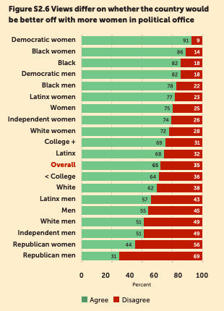
Overall support for more women in political office
Support is strongest among Democrats and Black Americans.
Least support among Republicans and white men.
In Louisiana, 87% of Black men and 82% of Black women agree, but only 26% of white men.
Notes:
REWRITE
Solid majority overall support more women in office
Support strongest among Democrats and Black Americans.
Least among Republicans and white men
Almost half of white men disagree that the country would be better off with more women in political office. Nearly 70 percent of Republican men think the same. By comparison, 91 percent of Democratic women do believe the country would be better off with more female leadership.
Interestingly, although 55 percent of Mississippi residents see benefits from having more women in office according to our YouGov/PerryUndem survey, women represent only 14 percent of state legislators.

Slide 18
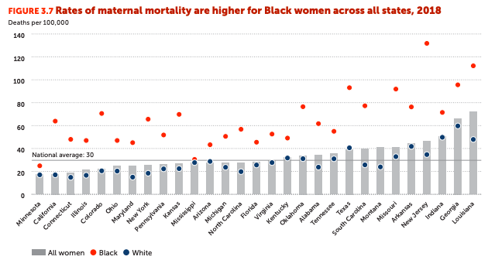
Major racial gaps in health
Source: America’s Health Rankings 2017.
Notes:
Maternal mortality rates are higher for Black woman than for white women in all states. Though data are missing for several states.
For Black women in New Jersey, maternal mortality rates average 132 deaths per 100,000 live births, nearly quadruple that for white women in the state and 4.4 times the national average. This rate is similar to that in Venezuela and worse than that in Iraq and Nicaragua
In Louisiana, maternal mortality rates for Black women average about 112 deaths per 100,000 live births. For white women, the rate is 48 deaths per 100,000 live births.

Slide 19
More highlights from our survey in Louisiana
Some important commonalities
Some striking differences include
About half (48%) of white men in LA say “it's a good time in LA to be a woman of color” – cf 1/8 (12%) Black women.
Less than half (47%) of Black women in LA/MS had enough money to cover their bills and basic needs, similar to national average for Black women; below male share (2/3).
Black women in LA/MS see gaps in opportunity: 81% agree that men have more opportunities in getting good-paying jobs, compared to 31% white men. (National average = 59%)
About 2/3 LA women of color feel unsafe sometimes or frequently because they are a woman; compared 1/3 of white women. (National average = 43%)
Majority overall support in LA for more women in office (57%), varying across groups:
82% of Black women in LA, but only a 26 % of white men
Broad support for work on gender equality:
About 4 in 5 LA adults (79%) believe it's important for elected officials to work on gender equality issues, similar to Mass (84%).
In Louisiana, majority support for work on gender equality across groups:
96 percent of Black women;
76 percent of men and
60 percent of white men.
70 percent of LA men say women's rights are important in state elections, higher than Mass (57 percent); 96 percent of Black men and 55 percent of white men in Louisiana

Slide 20
Ways forward
#USAindex
Tackle overlapping disadvantage – and especially constraints facing women of color.
More important than ever amidst COVID-19.
Close gaps in legal protection – from economic protections to ensuring abusers do not have access to firearms.
Ensure access to the full range of reproductive health services
Promote women’s voices – boost political representation
Need to improve the data – including on intimate partner violence and financial inclusion and ensure that data are racially disaggregated.
usa-index.com

